Slide 1
Overview RACING KIT
Components of the RACING KIT and Technical Data

Slide 2
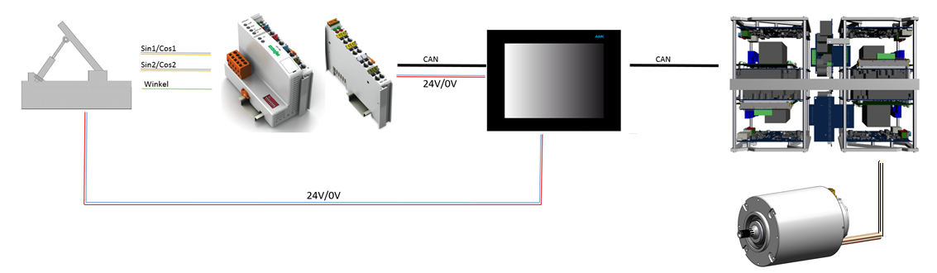
Gaspedal mit
Magnetsensoren
CAN Buskoppler mit analogen Eingangsklemmen
PLC CoDeSys Steuerung mit Display
RACING KIT
Wechselrichter
Servomotor

Slide 3

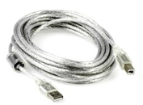
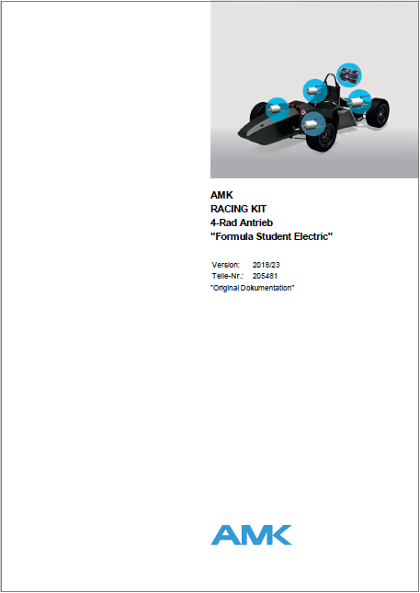

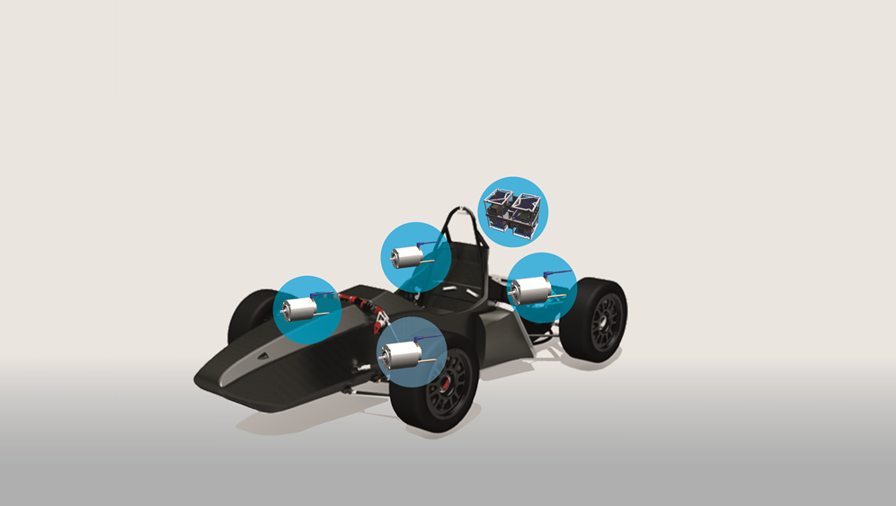


Product Overview RACING KIT
AMKmotion startup-
software AIPEX PRO
USB cable
Quad inverter with
AMK special software FSE,
(Formula Student Electric)
4 powerful synchronous
servo motors
with motor encoder system
Documentation
https://amk-motion.com/amk-dokucd/dokucd/FSE/start.htm
Training at AMKmotion
+
10 h support
via telephone
und email
application@amk-motion.com

Slide 4
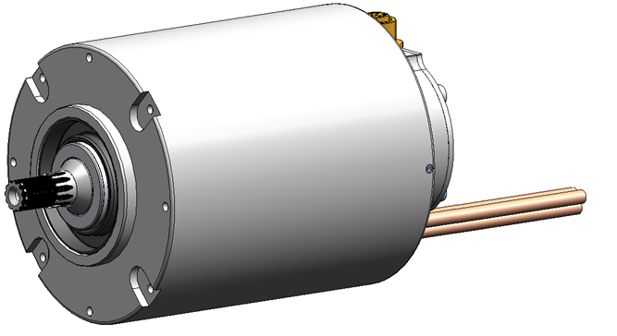

FSE Motor DD5
Performance data
Rated torque 9.8 Nm
Maximum torque 21 Nm for 1.24 s
Operation in field weakening up to 20.000 rpm
Integrated motor encoder
Digital EnDat encoder (18 bit)
Winding protection
KTY84 temperature sensor
Mechanical connection
Motor shaft with
shaft seal and
spline according
to DIN 5480
Motor housing
approx. 3,55 kg weight
approx. 96 mm diameter
approx. 135 mm length (without motor shaft)
10-pole synchronous servomotor
with permanent magnets
Liquid cooling jacket
must be constructed
by the user!

Slide 5
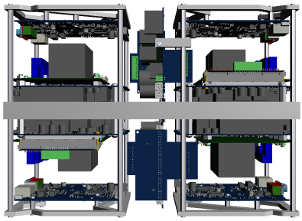
FSE Quad Inverter
FSE quad Inverter
4 independent working inverters
on a liquid cooled plate
approx. 339 mm length
approx. 183 mm width
approx. 241 mm height
approx. 11 kg weight
Supply and logic board
Connection board
Inverter 1
Inverter 2
Controller card
with FSE firmware
Power electronic
Liquid cooling plate
(connection side
cooling circuit)
A very well shielded housing
must be constructed by the user!
Inverter 3
Inverter 4

Slide 6
FSE Quad Inverter - Performance data
Input (rated data)
540 VDC (possible area 250 VDC - 720 VDC)
4 x 48 A
Output (rated data)
350 VAC (190 VAC - 490 VAC)
4 x 26 kVA
4 x 43 A
Output (max.)
4 x 107 A (fout > 1 Hz max. 10 s)
( fout < 1 Hz max. 1 s)
Motor regulation
Regulation of permanent-magnet synchronous servo motors
(torque control or torque control through torque limitation + dynamic speed limitation)
Motor and recuperative operation
Field weakening for higher speeds with simultaneously only slowly reducing motor torque
FSE Firmware
Torque limitation with increasing temperature (motor, power units, cooling plate)
or with increasing overload (inverter, motor)
Basic Battery protection, can prevent over and under voltage
Standard functions (monitoring functions, diagnostic messages, scope function ... )
Interface
CAN Slave, Startup software AIPEX PRO,
I/O interface (hardware inputs release power output stage, motor control and motor torque, output derating active.

Slide 7
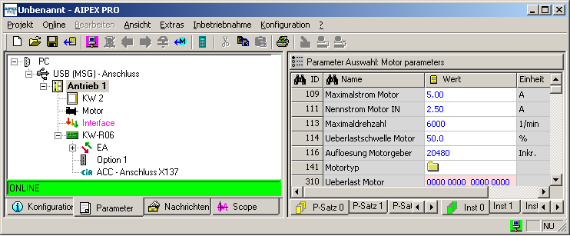
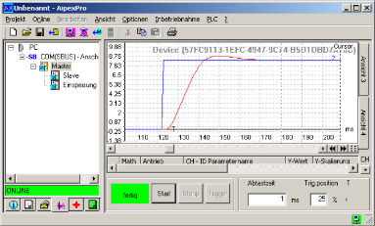
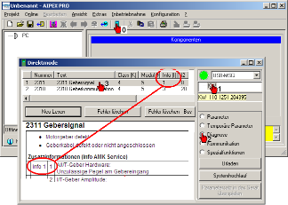
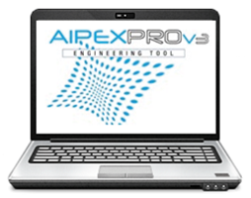

Startup Software AIPEX PRO + Examples
Device configuration
Parametrization
Commissioning support
Diagnostic
Communication
RJ45-Kabel (EtherCAT)
USB/Mini-USB Kabel

Slide 8
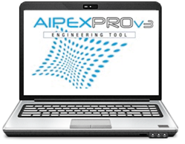




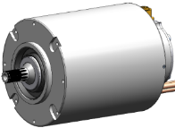



Complete System
SERVICE
4 x EtherCAT
4 x USB
2 x CAN
2 x EF power stage logic
4 x DI motor control and torque release
Motor encoder
Motor temperature
Motor phases
1
1
Charging and discharging circuit
for DC bus capacitors
General
grounding
Cooling
HV battery
24 VDC

Slide 9
Main Tasks for the Teams
Liquid cooling jacket motor
Inverter housing
Liquid cooling system for the drive system
Stable grounding and shielding concept
Power supply battery
Charging and discharging circuit for DC bus capacitors

Slide 10
What does the RACING KIT offer
Four wheel drive system
4 synchronous servo motors with a maximum torque of 21Nm at a weight of only 3.55 kg
Compact inverter with 4 independent operating inverters
Commissioning and parameterization software
Torque control, speed control, recuperation, field weakening
CAN Bus interface
Training
Support

